Slide 1
Testing Throughout SDLC

Slide 2
Learning Objectives
Software Development Models
Waterfall model
V-model (Sequential Development Model)
Iterative-incremental Development Model
Agile Methodology

Slide 3
Software Development Life Cycle
The Software Development Life Cycle is a step-by-step process involved in the development of a software product.
The whole process is generally classified into a set of steps and a specific operation will be carried out in each of the steps.
The basic classification of the whole process is as follows:
Initial
Analysis
Design
Coding
Testing
Maintenance
Initial:
The main aim of the initial phase is requirements gathering.
The responsible person is “BA – Business Analyst”
The outcome document name is “BRS – Business Requirements Specification”.

Slide 4
Contd..
Analysis:
Planning the project, Resource estimation, Schedule preparation, project prototype will takes place.
The outcome document name is “SRS – System Requirements Specification”.
At the end of this phase, both project plan and test plan documents are delivered.
Design:
Dividing the system into no. of module and sub-modules.
Preparing Data-flow diagrams, Control-flow diagrams, Use cases.
Designing Database
The outcome document name is “TDD – Technical Design Document”.
Coding:
The outcome is “Source code”.
In this phase requirements are analyzed for the feasibility of implementation.
The aim is to create the architecture of the total system(including database design).
In this phase, programmers prepares/write the code for given specification in the chosen programming language.

Slide 5
Contd..
Testing:
Main aim is, to verify that the given system working as per client requirements.
If test fails, they will raise an incident.
The outcome documents are: Test Cases, Incidents.
Maintenance:
Any issue raised by client, environmental problems are handled.
Requirements change requests are handled
Maintenance is made up of:
Corrective maintenance
Ex: fixing customer-reported problems
Adaptive maintenance
Ex: making the software run on a new version of an OS or Database.
Preventive maintenance
Ex: changing the application program code to avoid a potential security hole in an OS code
In this phase, testing team will execute the prepared test cases on the given build/system.
In this phase, the system deployed into the client’s environment.

Slide 6
Testing in SDLC
When do defects arise?
Requirement1
Understand customer requirement
Design correctly to meet requirement
Correct functional and non-functional attributes delivered
Build correctly to meet design
Requirement2
Understand customer requirement
Design correctly to meet requirement
In coding some mistakes are made and defects introduced
Product has bugs –it does not meet its design specs
Requirement3
Understand customer requirement
Designers made some mistakes
Build correctly to meet design
Product has design flaws
Requirement4
Mistakes in understanding customer requirement
Design correctly to meet flawed requirements
Build correctly to meet design
Wrong product delivered
Defect correction easy
–tester will fix
Hard to correct
Because
design changes
required
Acceptance testing
failure; very costly defects

Slide 7
Contd..
Impact of defects
A defect introduced during requirement specification and is not detected until acceptance testing –it will be more expensive to fix
Cost
Cost in fixing defects
increases over time
Time
Requirements
Design
Build
Test
Use
←SDLC Phases →

Slide 8
Contd..
Phase | Errors passed in | Errors amplified | Errors introduced | % of errors found in testing
Analysis | 0 | 0 | 10 | 0%
let 10 errors introduced in analysis phase; 6 are crept into design phase remaining 4 of them get amplified by 50%.
Phase | Errors passed in | Errors amplified | Errors introduced | % of errors found in testing
Design | 6 | 6 | 25 | 0%
out of 37 passed to coding phase, 10 are passed as it is; remaining 27 of them get amplified by 200%.
Phase | Errors passed in | Errors amplified | Errors introduced | % of errors found in testing
Coding | 10 | 81 | 25 | 20%
out of 116, 20% are detected by testing and rest of 93 passed to integration phase as is;
Integration phase will not have any amplification.
Phase; | Errors passed in | Errors amplified | Errors introduced | % of errors found in testing
Integration | 93 | 0 | 0 | 50%
No of errors passed to system test phase are 50% of 93; no amplification of errors; 24 defects delivered to customer
Phase; | Errors passed in | Errors amplified | Errors introduced | % of errors found in testing
Systst | 47 | 0 | 0 | 50%

Slide 9
Software Development Models – Waterfall model
Waterfall Model
In "The Waterfall" approach, the whole process of software development is divided into separate process phases.
All these phases are cascaded to each other so that second phase is started as and when defined set of goals are achieved for first phase and it is signed off, so the name "Waterfall Model".
All the methods and processes undertaken in Waterfall Model are more visible.
Requirements
Code
Design
Testing
Release

Slide 10
Contd..
Advantages
Disadvantages
It is the simplest software process model in terms of complexity and ease of implementation. As you know, it is nothing but common sense.
This model is extremely easy to understand and therefore, is implemented at various project management levels and in a number of fields (not just software development).
It employs a systematic, orthodox method of project development and delivery.
All requirements must be known upfront
Jumping back and forth between two or more phases is not possible.
The next phase can be reached only after the previous one has been completed.
Bugs and errors in the code cannot be discovered until and unless the testing phase is reached. This can lead to a lot of wastage of time and other precious resources.
Not suitable for projects wherein the project requirements are dynamic or constantly changing.

Slide 11
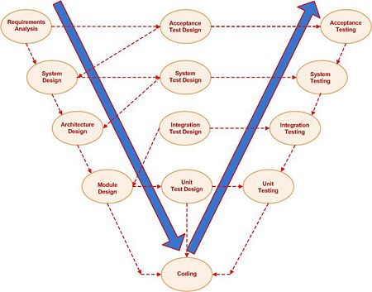
V-Model

Slide 12
Contd..
A framework to describe the software development lifecycle activities from requirements specification to maintenance. The V-model illustrates how testing activities can be integrated into each phase of the software development lifecycle.
The V-Model demonstrates the relationships between each phase of the development life cycle and its associated phase of testing.
Testing helps to ensure that the work-products are being developed in the right way (verification) and that the product will meet the user needs (validation).
Checks that the work-product meets the requirements set out for it.
Validation
Checks that the behavior of the work-product matches the customer needs as defined for the project.
Verification helps to ensure that we are building the product in the right way.
Validation helps to ensure that we are building the right product as far as the users are concerned.
Verification

Slide 13
Contd..
V-Model Objectives:
Minimization of Project Risks
Improvement and Guarantee of Quality
Reduction of Total Cost over the Entire Project and System Life Cycle
Improvement of Communication between all Stakeholders

Slide 14
Contd..
Advantages
Limitations
The users of the V-Model participate in the development and maintenance of the V-Model.
A change control board publicly maintains the V-Model.
The change control board meets once a year and processes all received change requests on The V-Model.
At each project start, the V-Model can be tailored into a specific project V-Model, because the V-Model is project independent.
It provides concrete assistance on how to implement an activity and its work steps, defining explicitly the events needed to complete a work step: each activity schema contains instructions, recommendations and detailed explanations of the activity.
The placing of contracts for services is not regulated.
The organization and execution of operation, maintenance, repair and disposal of the system are not covered by the V-Model. However, planning and preparation of a concept for these tasks are regulated in the V-Model.
The V-Model addresses software development within a project rather than a whole organization.

Slide 15
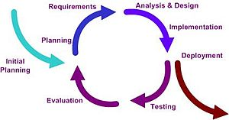
Iterative-Incremental Model
This is one where the requirements do not need to be fully defined before coding can start. Instead, a working version of the product is built, in a series of stages, or iterations - hence the name iterative or incremental development.

Slide 16
Contd..
An Iterative model for development has fewer steps those are:
1) Define Iteration Requirements
2) Build Iteration
3) Test Iteration
This type of development is often referred to as cyclical - we go ‘round the development cycle a number of times’, within the project.
Example:
Assuming a development of a social networking website with parts like member registration, sign in, forgot password, member profile, search members, friends list, blog, blog search, photos, photo search and messaging.
Development:
First iteration comprising of member registration, sign in, member profile and search members.
The second iteration can comprise of friends list, blog, blog search.
The third iteration can comprise of photos, photo search, messaging and forgot password.

Slide 17
Contd..
Drawbacks:
The lack of formal documentation makes it difficult to test.
The working environment may be such that developers make any changes required, without formally recording them.
The amount of testing required to ensure that implementation of the changes does not cause unintended changes to other parts of the software (this is called regression testing).

Slide 18
Agile Testing

Slide 19
What is Agile Testing ? –Agile values
Agile Values
(Agile Manifesto)
Roles and Activities
How it is different?
Whole team approach
Core value1: Individuals and interactions over processes and tools:
Core value 2: Working software over comprehensive documentation:
Core value 3: Customer collaboration over contract negotiation:
Core value 4: Respond to change over following a plan:
Undocumented process with good interactions among the stake holders , than a documented process with less interactions
Running code is ruthlessly honest
Customer is part of development process; it is collaboration in decision meeting, speed of communication and individual's connect
Rather than focusing on outdated plan, deal with changing realities

Slide 20
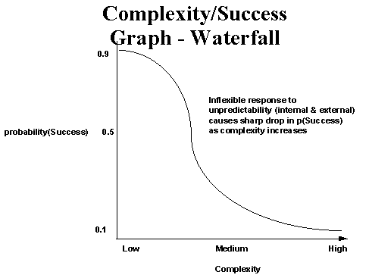
Water fall model –Success factors
Complexity = f( development+ target) environment variables
Successful: The system is useful when it is delivered

Slide 21
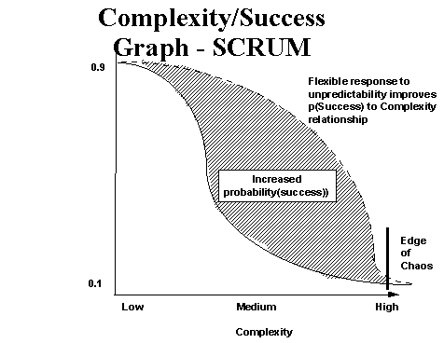
Agile – Success factors
Risk reduction: analyzing, prioritizing and attacking the top risks in each iteration
Walker Royce, Software project management: A unified framework, 1998, AW

Slide 22
What is Agile Testing –Meaning whole Team approach
Business facing tests –tests that describe customer’s desired features and functionalities
It includes functional, system, load, performance, stress, security, usability ..
Agile testing –does not mean testing on an agile project. Testing is inline with valuing working software and responding to change
In Agile not only testers or a quality assurance team own the responsibility for quality –but entire team
We just don’t think of departments -rather the skills and resources we need to deliver the best possible product.
Business facing tests –tests that describe customer’s desired features and functionalities
Focus of agile development is producing high quality software in a time frame that maximizes its value to the business.
Any task might be completed by any team member or a pair of team members
Team takes the responsibility of all kinds of testing tasks, such as automating tests and manual exploratory testing

Slide 23
Agile Testing –Roles and Activities
Customer Team
Includes business experts, product owners, domain experts, product managers, business analysts, Subject Matter experts
Developer Team
Customer team writes the stories or feature sets that the developer team delivers
They communicate and collaborate with the developer team through out each iteration
Testers are integral part of the customer team helping elicit requirements and examples and helping the customers express their requirements as tests, make sure the tests pass, and make sure that adequate regression tests are automated
Interaction of roles
Testers are also on the developer team
Discourage specialized roles on the teams and encourage all team members to transfer their skills to other members as much as possible
Involved in delivering code
Programmer
Domain Expert
Tester

Slide 24
How Agile Testing is different?
Requirements
Code
Software Specifications
Testing
Release
I₁ |  | I₂ |  | I₃ |  | I₄
 |  |  |  |  |  | E
 |  |  |  | D |  | D
 |  | C |  | C |  | C
A | B | A | B | A | B | A | B

Slide 25
Traditional Vs Agile Testing
In water fall model, testing happens towards the end, right before release
It appears that there is as much time for testing as coding –but in reality it is not the case –Testing gets squished because coding takes longer time than expected
Requirements are taken as inputs and tests are created from a requirement document
Agile is incremental with intermediate releases
Testers test each increment of coding as soon as it is finished (An iteration can be as short as one week or one month)
Team builds and tests little bit of code, make sure that it works correctly and then moves on to the next piece of requirements that need to be built.
A story is not “done” until it has been tested
One team might be dedicated to a single project or might be part of another project
Tests normally created by business analysts before anyone ever thought of writing a line of code. It is collaborative effort.

Slide 26
Ten Principles for Agile Tester
Agile Tester is a professional tester who embraces change, collaborates well with both development and business team
10 Principles important for agile testers:
Provide continuous feedback: Feedback helps the team in removing impediments
Agile testers tend to have good technical skills
collaborate with others to automate tests, are also experienced exploratory testers
better understand customer’s requirements
Deliver value to the customer: Tester helps the team in limiting the scope and recognizes impact of cool features to the story
Enable face to face communication: Any time there is a question about how a feature should work, tester can pull in a programmer and a business expert to talk about it.
Have courage: It is a core value in XP such as test automation; continuous integration allow the team. We need courage to let ourselves fail, learn quickly from that; allow others to make mistakes, to seek help –when we’ve blown up an iteration because we didn’t get a stable build, we will start thinking of ways to ensure it does not happen again
Keep it simple: Take a simple approach to ensuring that the software meets requirements
Practice continuous improvement
Respond to change
Self organize
Focus on people
Enjoy

Slide 27
Thank you

